Slide 1
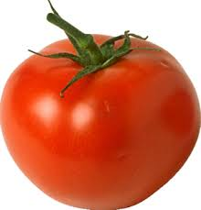
World Religion: Judaism
Lets start by exploring what you already know.
On your desks write done any key words/ phrases/ ideas that you know about Judaism.
Why do you think some people would say Judaism is like a tomato?

Slide 2
Fruit ?
Vegetable ?
Technically a fruit, but used and understood by many as a vegetable.
In the same way, Judaism is technically a religion but it is understood by many as an ethnic group or a race of people.

Slide 3

Therefore the best way to understand Judaism is to see it from within.
To try and see this from a Jewish viewpoint.
To take the time to learn how Jewish people see their faith.
In order to do that we need to start at the beginning….

Slide 4
7.6.22 Judaism: an Introduction
Create a mind map detailing the information on this slide.
Judaism is one of the oldest religions in the world. It is thought to have begun around 4000 years ago.
It originated in Israel in the Middle East.
Judaism is a world religion. This is because Jewish people can be found throughout the world; speaking different languages and belonging to different races and nations.
Judaism teaches there is a God
The Jewish faith is centred on relationship. Relationship between God and relationship with each other.

Slide 5
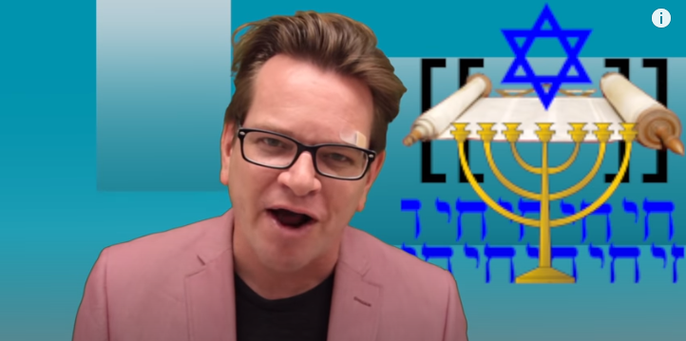
It is tricky to find a good short introduction to Judaism but the first 4 minutes of this are good.
Take a look and note down three other facts you have learnt.
You might want to focus on the numbers or some of the other ideas he introduces.
https://www.youtube.com/watch?v=PWsKZ2Xto4Y

Slide 6
But what or who is God?
“Through the history of the universe and in every civilization, people have thought there has to be more to life than just what we can physically see and touch.
A belief in a god or gods is a naturally occurring idea and for many there is a need to be a belief or view that something more powerful or transcendent exists, on which many build their lives on.” Anon
What are some of the key phrases that strike you in this quote?

Slide 7
But what or who is God?
“Through the history of the universe and in every civilization, people have thought there has to be more to life than just what we can physically see and touch.
A belief in a god or gods is a naturally occurring idea and for many there is a need to have to believe that something more powerful or transcendent exists.” Anon
Lets consider the 5 words/phrases that are underlined. What do they actually mean? Take a few minutes to think about each one and discuss your ideas, then I will ask people to share their thoughts.

Slide 8
more to life
physically see and touch.
naturally occurring idea
there is a need
transcendent

Slide 9

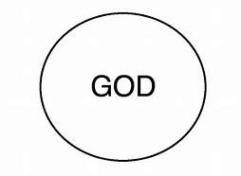
Judaism teaches that God has certain characteristics.
One of the most important is Monotheism.
Monotheism is belief in one God
Mono = One
Theism = Belief in the existence of God.

Slide 10
The names of G-d
Jews believe that there is only one Gd.
It is very difficult to describe God, because everyday language is always about ordinary things but God is not ordinary.
G-d is ‘holy’ meaning special, separate and different.
Because this God is impossible to describe in words his name is very important and only used with great respect.

Slide 11
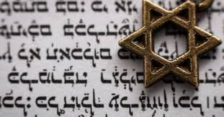
In the Hebrew scriptures that name is written as JHWH, since Hebrew script originally contained no vowels
This is also why his full name is not always written down.
Often G-d is written instead.
Jews also call God Adonai which means 'Lord‘, or ‘Hashem’ which means ‘the name.’

Slide 12
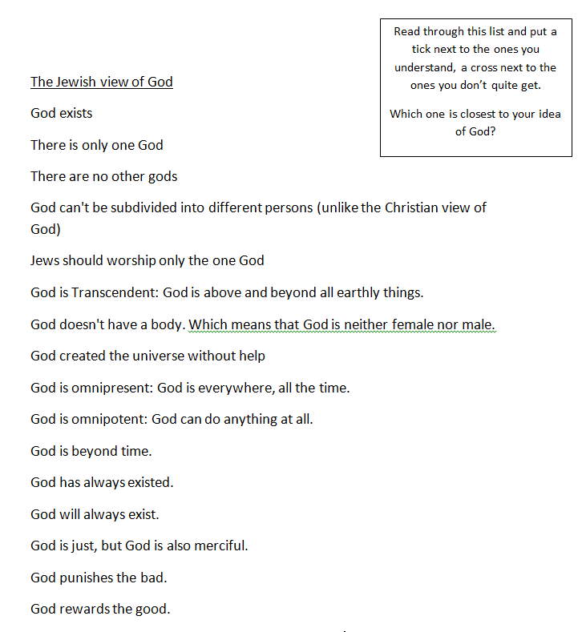
The nature of God
The Jewish faith has many ways of thinking about God.
Take a look at the sheet and tick or cross as asked.
Stick this into your jotter

